Slide 1
DL WEEK - Session 1
Basic fundamentals of Machine Learning, Introduction to Pytorch

Slide 2
Artificial Intelligence
Artificial Intelligence: means getting a computer to mimic human behaviour in some way.
While some people falsely consider AI a technology, the more accurate approach would be seeing it as a broad concept in which machines can deal with tasks in a way we would call intelligent or smart.

Slide 3
Machine Learning
So is Artificial Intelligence and Machine learning the same? Not really. Artificial Intelligence is a broader concept while machine learning is a very common application of AI.
For example: If we give computer information about weather patterns for the last few years. The computer can use “machine learning” algorithms to predict the weather condition tomorrow or the day after and so on.

Slide 4
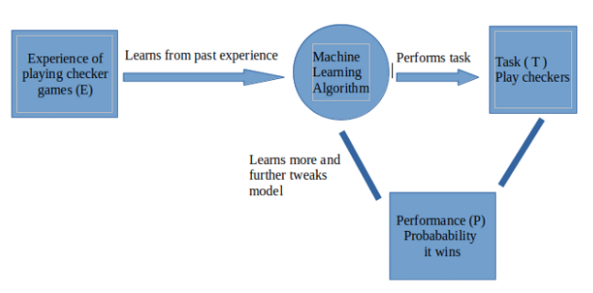
A more formal definition of Machine Learning
A computer program is said to learn from experience E with respect to some task T and some performance measure P, if its performance on T, as measured by P, improves with experience E.
Task: Play checkers
Experience: Past checkers games
Performance: Winning/Losing

Slide 5
Supervised and Unsupervised
Broadly a ML problem can be classified into supervised and unsupervised problems.
Supervised: we train a model with data which is already labelled or in simpler words we have a dataset which contains information about what the actual output must look like. So once the model learns from this “Training data” it tries to predict the output for a new set of examples by establishing a relationship between the input and output.
Unsupervised: training of machine using information that is neither classified nor labelled and allowing the algorithm to act on that information without guidance. Here the task of machine is to group unsorted information according to similarities, patterns and differences without any prior training of data.

Slide 6
Regression and Classification
Supervised learning problems can be further classified into regression and classification problems
Regression: Whenever we are trying to predict results within a continuous output, meaning we are trying to map some input variables to some continuous function. For example: Given the characteristics of a mobile phone, we need to predict the approximate price of the mobile phone.
Classification: Whenever we are trying to classify the output into specific categories, meaning we need to map some input variables to output some discrete values. For example: Given an image of an animal, we need to classify into whether its a cat or a dog.

Slide 7
Clustering
Classification
Regression

Slide 8
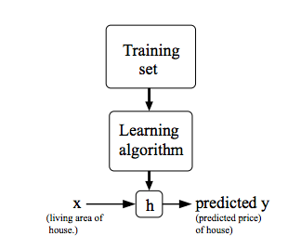
Linear Regression
As the name suggests, a linear regression model tries to map the output variable with the input variable in a linear fashion. In rather simpler words, a linear regression model assumes a linear relationship between a dependent, continuous variable Y with one or more independent variables called X.
Y = MX + C
Here,
Y = dependent, continuous variable (eg: cost of a house)
X = independent (eg: square feet area of house)
M, C = weight and bias terms of the linear regression model

Slide 9
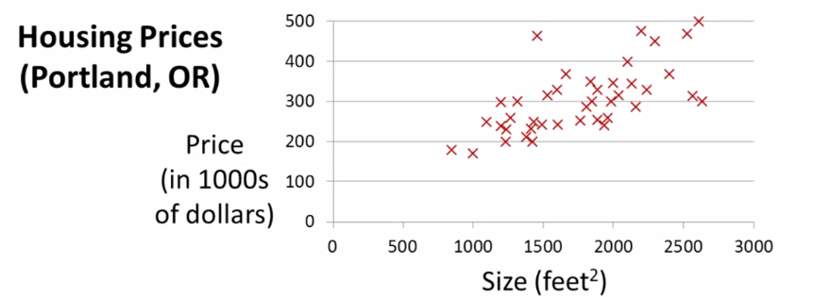
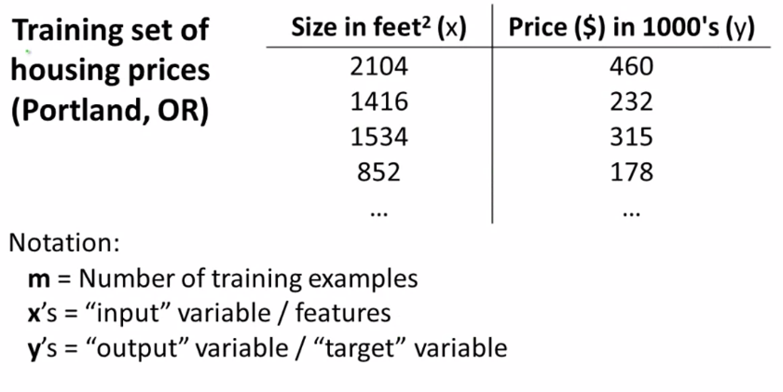
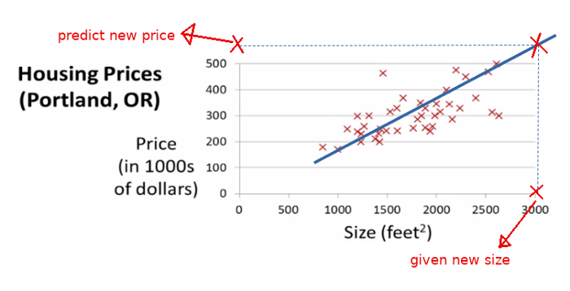
BUT, How do you determine the best fit line
(or)
How do you find the values of m and c for optimal solutions

Slide 10
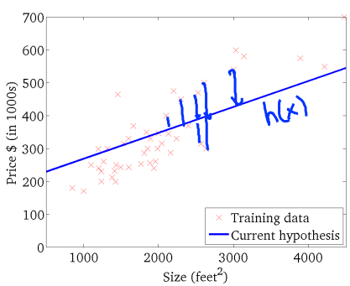
Cost function
we need to have a metric to evaluate how well our model is fitting the given data. This metric is modelled into a function which we call a cost function. So the cost function defines how much the given line is deviating from the points in the given dataset.
We need to model our cost function in terms of our parameters which define the line so that we can find the “optimal” set of parameters when the cost is minimum.

Slide 11
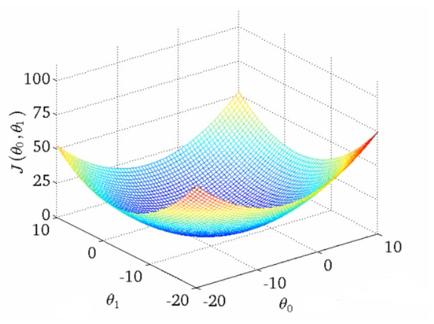
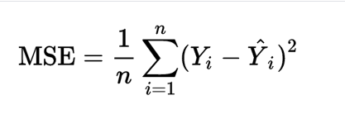
Mean Squared Error
predicted
groundtruth

Slide 12
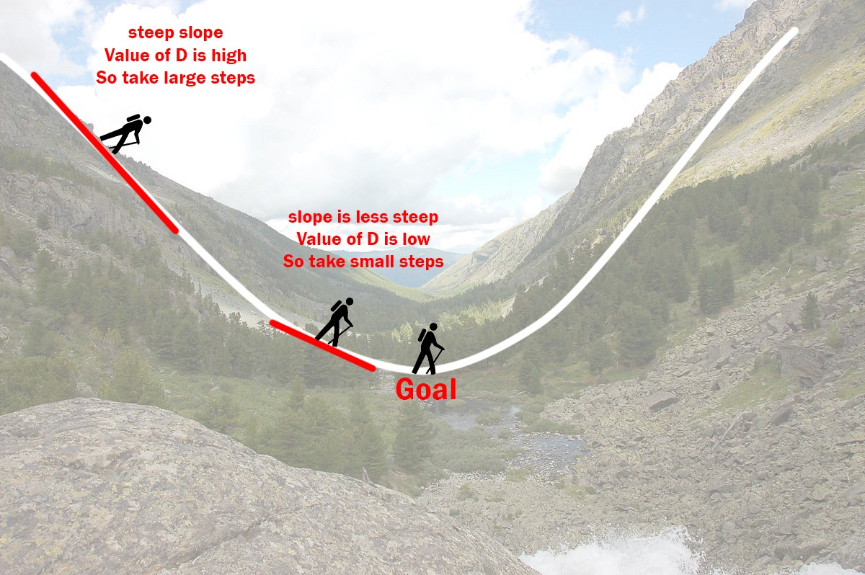
Gradient Descent
Let’s imagine a valley where a person at the top has to reach the bottom of it and the person has no clue as to which direction the minima is.

Slide 13
When the person is on the left of the minima, the slope at the point at which he is standing is negative. Now suppose we subtract this negative value from the value of m and c at that particular point we can see that m and c would increase (subtracting a negative value basically adds it) and hence the person would move closer to the minima (i.e) to the right.
Similarly, if the person is on the right of the minima the slope at that point is positive and hence by subtracting this positive value from m and c, the person would move towards the minima (i.e) to the left.
As the person moves closer and closer to the minima the slope would decrease and hence the person would take smaller and smaller steps. Hence the person can’t reach the exact minima but go as close as possible to it.

Slide 14
Hence the aim of a linear regression model should be to reduce the cost as much as possible but since it can never reach the absolute minima, we can stop training once the cost is saturated.
(i.e the model can’t improve further).

Slide 15
Gradient Descent for Linear Regression

Slide 16
Some important points
Learning rate: whenever we update the values of m and c, we must ensure that we take sufficiently small steps so that it wouldn't overshoot or cross the minima and move to the other side. For example, if we are at the highest point on the peak the value of the slope at that point is very high and hence there is a high possibility that if we don’t scale down the step size we can overshoot and cross the minima.
Initial values of m and c: Frankly speaking, there is no ideal initial value. A common practise is to randomly initialize the starting values and proceed from there. What happens when you initialize the values to 0???
Multiple optimas: We have taken a simple ideal case, where there are no local minimas. There is high chance that the model can converge to these local minimas which is not entirely useful in our case.

Slide 17
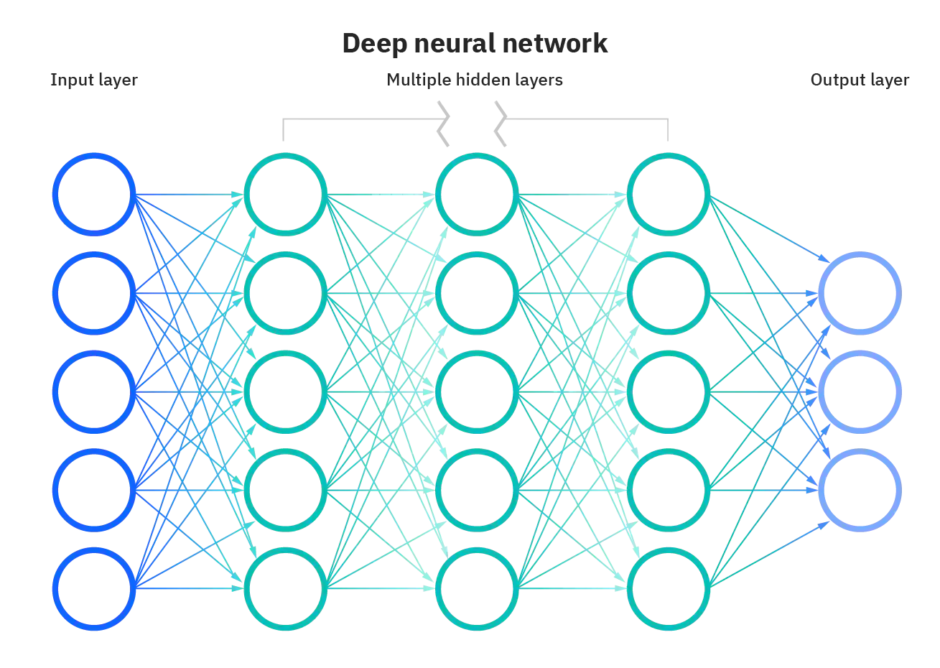
Neural Networks
Neural Networks (also called ANNs) are the fundamental units in Deep Learning. When broken down, it can be understood as multiple linear regression units with some functions (also called activation functions) which help model complex mappings between the input and output

Slide 18
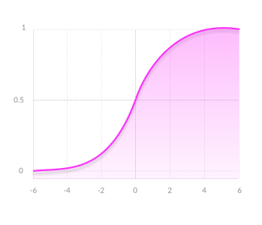
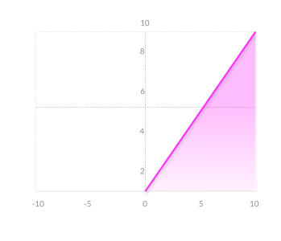
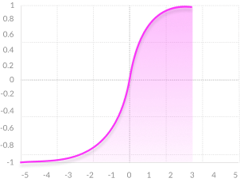
Activation Functions
sigmoid
tanh
ReLU

Slide 19
Intuition of how Neural Networks work

Slide 20
What’s Next?
During the coming sessions, we will look more closely at the different types of neural networks out there, how they work and how they can be used for various applications like image recognition, language understanding, etc.
Now let's talk a bit about pytorch

